Slide 1



Sync 1.2 The Big picture
UHC Summer Institute- June 26-30, 2023
Ran Li, Ms
Ana Ortigoza, MD PhD

Slide 2
Overview
Funding requirements
FAIR/CARE principles to the rescue
Implementation Road map
Domain discussion

Slide 3
Why: Maximizing funding impact
Funders aim to maximize the impact of their investments in research.
One key strategy is to ensure that the outputs of funded research, particularly data, are reusable.
Reusable data can be leveraged by other researchers, multiplying the impact of the original funding.
Notes:
The evolution of best practices in data management has seen a significant shift over the years, moving from a focus on open data to the adoption of FAIR and CARE principles. This progression reflects the changing understanding and recognition of the complexities involved in data management, particularly in the context of research and public data.
Open Data was the initial step in this evolution. The concept of open data advocates for data to be freely available to everyone to use and republish without restrictions. This was a significant first step in promoting transparency and collaboration, particularly in the scientific community. However, it soon became apparent that simply making data open was not enough to ensure its effective use.
This led to the development of the FAIR Principles, which emphasize not just the accessibility of data, but also its Findability, Interoperability, and Reusability. The FAIR principles recognize that data needs to be easily discoverable, able to be integrated with other data, and reusable in different contexts. This is achieved through the use of standards and controls that ensure data is well-described and stored in a way that facilitates its reuse.
Most recently, the CARE Principles have been developed to address the rights and interests of Indigenous Peoples in relation to their data. These principles emphasize Collective Benefit, Authority to Control, Responsibility, and Ethics. The CARE principles recognize that data about Indigenous Peoples has often been collected and used in ways that do not benefit them, and seek to rectify this by ensuring that Indigenous Peoples have control over their data and that it is used ethically and responsibly.
This historical context shows a clear progression from a focus on simply making data available, to ensuring it is usable and benefits those it pertains to. It reflects a growing understanding of the complexities of data management and the need for standards and controls to ensure data is not just accessible, but also findable, interoperable, reusable, and used ethically and responsibly.

Slide 4
Funding requirements
NIH Data Management and Sharing Policy (DMS)
The NIH requires a Data Management and Sharing plan as part of grant applications.
This plan outlines how data will be managed during the project and shared upon completion.
Adherence to FAIR principles can help meet these requirements and enhance the potential impact of the research.
NSF Data Management Plan (DMP)
Similarly, the NSF requires a Data Management Plan in grant applications.
This plan should detail how data will be curated, preserved, and shared.
Implementing FAIR principles in these plans can ensure the data is reusable, meeting NSF requirements and increasing the value of the research to the scientific community.
Notes:
"In this slide, we're going to delve into how major funding bodies, specifically the National Institutes of Health (NIH) and the National Science Foundation (NSF), have formalized the requirement for data reusability in their grant submission processes."
"Starting with the NIH, they require a Data Management and Sharing plan, often abbreviated as DMS, as part of their grant applications. This plan is a crucial document that outlines how data will be managed during the project and how it will be shared upon the project's completion. It's not just about collecting data, but also about ensuring that the data can be effectively used by others in the future."
"Adherence to the FAIR principles can greatly assist in meeting these requirements. By making sure your data is Findable, Accessible, Interoperable, and Reusable, you're not only increasing the potential impact of your research but also aligning with the NIH's expectations for data management and sharing."
"Similarly, the NSF also requires a Data Management Plan, or DMP, in their grant applications. This plan should detail how data will be curated, preserved, and shared. It's about ensuring the longevity and accessibility of your data."
"Again, implementing the FAIR principles in these plans can ensure your data is reusable, which not only meets the NSF's requirements but also increases the value of your research to the broader scientific community. In essence, by making your data FAIR, you're extending the reach and impact of your research, which is a win-win situation for both you as a researcher and the funding bodies."
"In conclusion, the formalization of data reusability in the grant submission process underscores the importance of good data management practices and the value of making research data FAIR."

Slide 5
Leverage FAIR Principles in DMS and DMP
FAIR Principles as a Resource
The FAIR principles provide a clear, internationally recognized framework for data management.
They encapsulate best practices in making data Findable, Accessible, Interoperable, and Reusable.
Alignment with DMS and DMP Requirements
Both NIH's Data Management and Sharing (DMS) and NSF's Data Management Plan (DMP) require clear plans for data management and sharing.
The FAIR principles align perfectly with these requirements, providing a roadmap for creating effective DMS and DMP.
Enhancing Research Impact
By adhering to the FAIR principles, researchers can ensure their data is readily available for reuse, thus increasing the potential impact of their research.
This aligns with the goals of funders like NIH and NSF, making FAIR-adherent DMS and DMP more likely to be favorably reviewed.
Notes:
"Before we move on, let's take a moment to understand why the FAIR data principles are such a valuable resource when writing Data Management and Sharing plans, or DMS, and Data Management Plans, or DMP. The FAIR principles provide a clear, internationally recognized framework for data management, encapsulating best practices in making data Findable, Accessible, Interoperable, and Reusable. These principles align perfectly with the requirements of both the NIH's DMS and the NSF's DMP, which require clear plans for data management and sharing. By adhering to the FAIR principles, researchers can ensure their data is readily available for reuse, thus increasing the potential impact of their research. This aligns with the goals of funders like NIH and NSF, making FAIR-adherent DMS and DMP more likely to be favorably reviewed."

Slide 6
Evolution of Data Stewardship
Open Data
freely available.
DATA
FAIR Principles
standards ensure data is well-described and stored in a way that facilitates its reuse.
METADATA
CARE Principles
Address ethics of data in regards to indigenous/marginalized populations
ETHICS

Slide 7
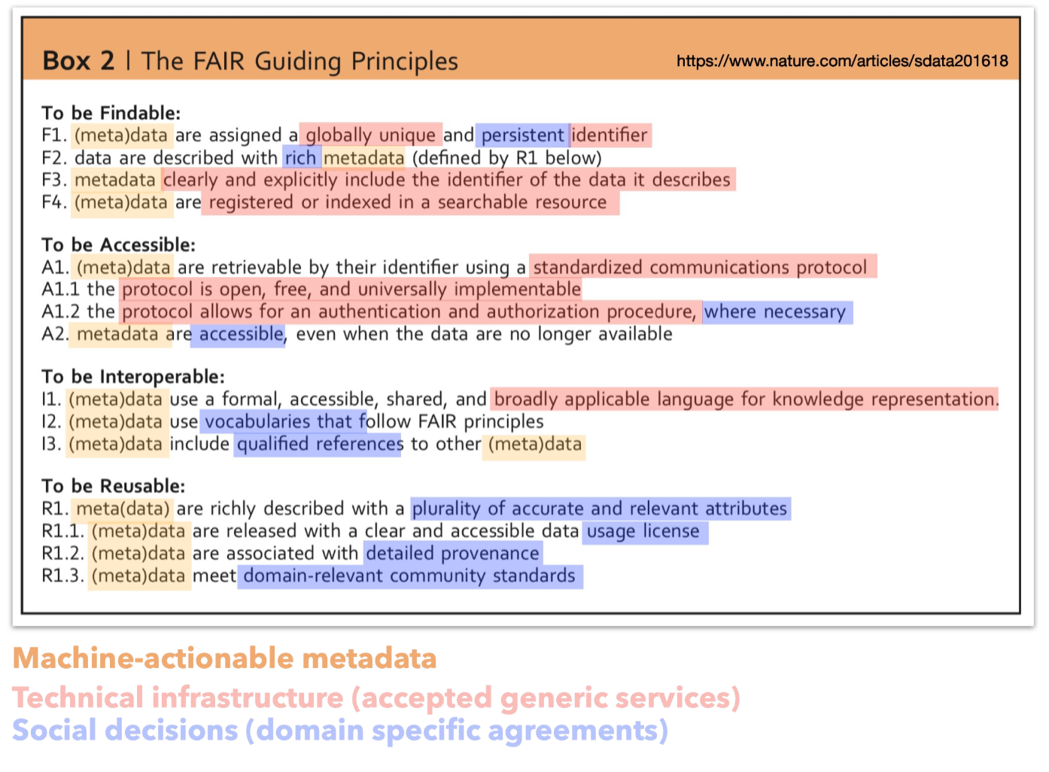
FAIR Overview
Notes:
FAIR principles are set of best practices for data management. That has three main components
1. You see metata in almost every sub principle of FAIR. metadata that is machine actional is key to making data reusable. "Metadata is often described as 'data about data.' It provides information about other data, making it easier to understand, find, and work with. To put it in simpler terms, think of metadata as the label on a can of soup. The label tells you what's inside the can, the ingredients, the nutritional information, and so on. Without the label, you wouldn't know what's inside the can. Similarly, metadata provides key information about data, such as what the data represents, who created it, when it was created, and other details that help users understand the context and content of the data."
2. Technical implementations that are domain agnostic
3. Domain specific components: what's the vocabular your are using, what are there info most important to help yo find, understand datasets (blue)

Slide 8
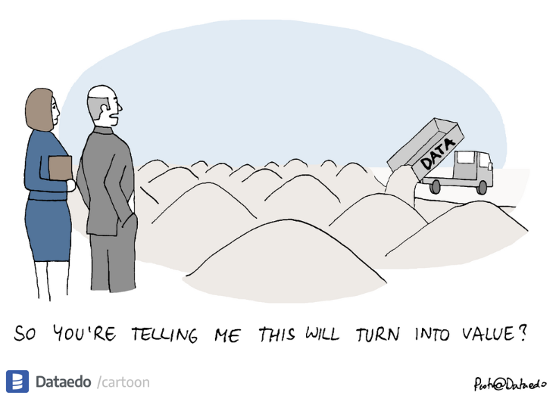
Data

Slide 9
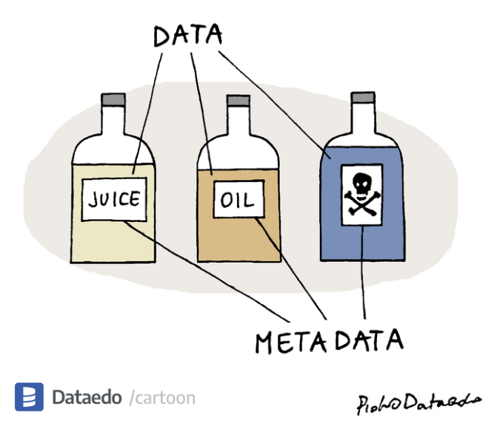
metaData

Slide 10
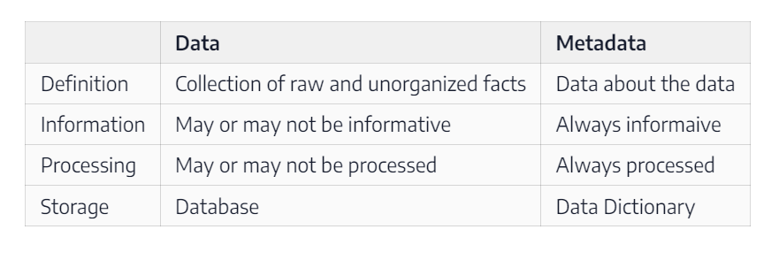
Data vs Metadata

Slide 11
Evolution of Data Stewardship
Open Data
freely available.
DATA
FAIR Principles
standards ensure data is well-described and stored in a way that facilitates its reuse.
METADATA
CARE Principles
Address ethics of data in regards to indigenous/marginalized populations
ETHICS

Slide 12
How to implement
FAIR and CARE are best practices and not an implementation roadmap
Within the research community there is only now just a realization of important of FAIR and CARE
There is no field specific convergence in how to implement it.
This workshop will go through a one potential implementation plan inspired by
Getting practical with FAIR from the NIH/CODATA
Our work with SALURBAL and other data projects at the UHC
These principles and implementation may help you write DMS/DMP in the future
Notes:
"As we've discussed, the FAIR and CARE principles represent best practices in data management. However, it's important to understand that they are not an implementation roadmap. They provide the 'what' - the goals we should aim for - but not the 'how' - the specific steps to achieve those goals."
"In the research community, there's a growing realization of the importance of these principles. More and more, researchers are recognizing that making data Findable, Accessible, Interoperable, Reusable, and Ethical is not just good practice, but essential for maximizing the impact and value of their work."
"However, there's currently no field-specific convergence on how to implement these principles. Different fields, and even different projects within the same field, may have different needs and challenges when it comes to data management."
"That's where this workshop comes in. Our goal is to provide you with a practical, adaptable roadmap for implementing the FAIR and CARE principles in your own work."
"Our approach is inspired by 'Getting practical with FAIR,' a resource developed by the NIH and CODATA. This resource provides practical guidance on how to make data FAIR, and we've adapted it to fit the needs and context of our workshop."
"We've also drawn on our own experiences with projects like SALURBAL and other data projects at the UHC. These projects have given us firsthand insight into the challenges and opportunities of implementing FAIR and CARE principles in real-world settings.“
We will focus on the big picture of implementing FAIR step by step without going into technical details as the technical impelmentat may change but the semantics will not.
"So, as we move forward, keep in mind that our goal is not just to teach you about the FAIR and CARE principles, but to give you the tools and knowledge you need to put these principles into practice in your own work. Particularly when writing funder require DMP and DMS plans."

Slide 13
Roadmap
Intro - Big Picture - 6/26
Define FAIR meta(data) – 6/27
Collect FAIR meta(data) – 6/28
Utilize FAIR meta(data) – 6/29
Putting it all together in a DMS/DMP – 6/30

Slide 14
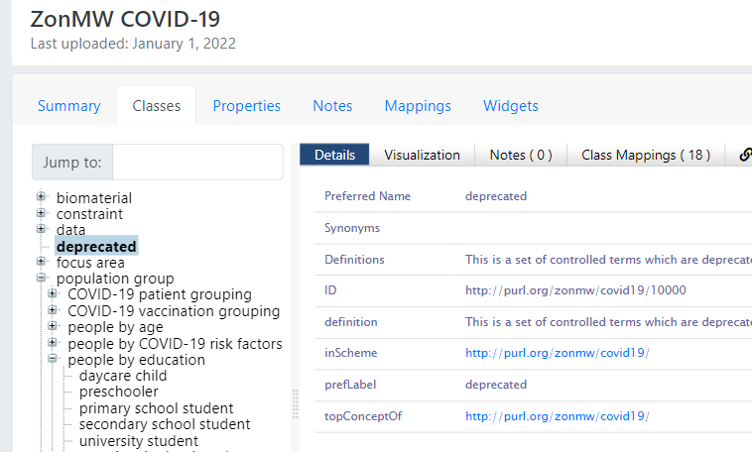
1. Define FAIR meta(data)
Introduction to controlled vocabularies and their role in making data Findable and Interoperable.
Hands-on session with Simple Knowledge Organization System (SKOS) and BioPortal.
Discussion on how these tools can be used to standardize data and enhance its reusability.
Notes:
The first step is to get an idea of what type of metadata our project will need aka controlled vocabularies. These are essentially predefined lists of terms that are used to tag and categorize information, providing a consistent way to describe and organize data. (e.g. what is a variable, what is a data point, what is a subject). They are crucial tools for making data Findable and Interoperable, two of the key FAIR principles. We'll have a hands-on session looking at shared controlled vocabularies and then look at how we can generate a controlled vocabulary (SKOS) and share it with BioPortal. By the end of the day, you'll have a solid understanding of what are controlled vocabularies are and how they can make your data more FAIR."

Slide 15
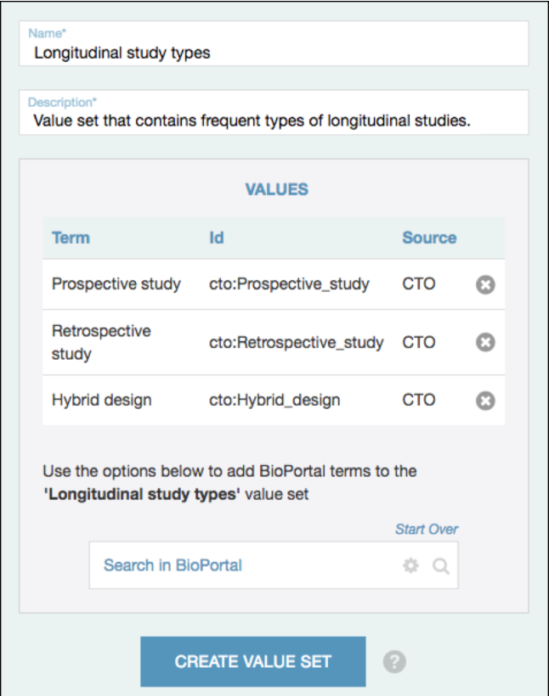
2. Collect FAIR Meta(data)
We now have defined a controlled vocabulary, now we can collected meta(data)!
Hands-on session with the CEDAR Workbench, a tool for creating, managing, and using metadata.
Integration between Bioportal and CEDAR
Notes:
Now we have defined a controlled vocabulary to talk about our project, we can now use it to generate interfaces to collect data(metadata). On Wednesday we will introduce CEDAR workbench, a tool for creating, managing and using metadata. By the end of the day, you will gain familiarity with a possible tool to enforce FAIR metadata collection.

Slide 16
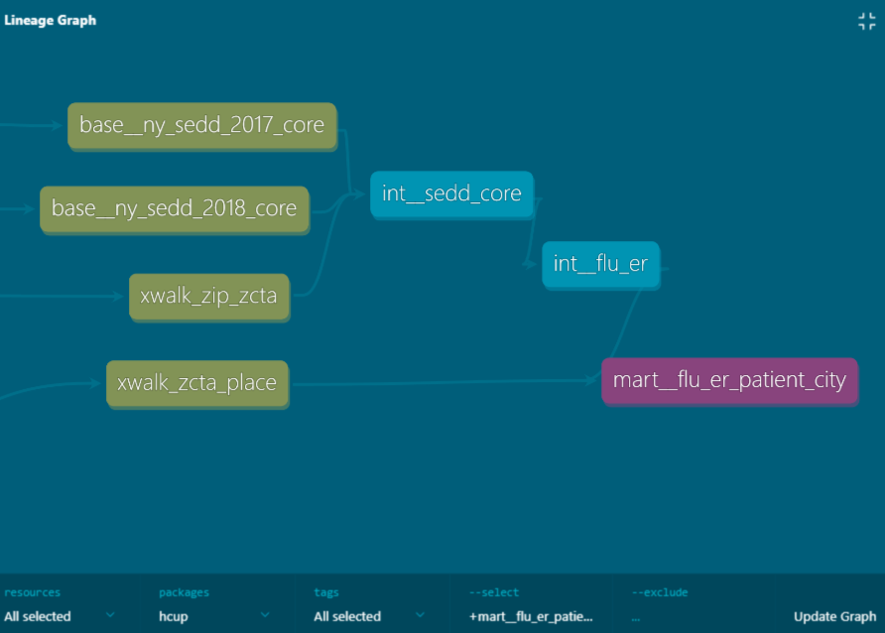
3. Utilize FAIR Meta(data)
We now machine actionable primary meta(data).
How can we best utilize it for analytical purposes?
How can we maintain the lineage of meta(data) downstream?
Interactive demo with Data Built Tools. A modern data warehousing framework.
Notes:
On Thursday, we'll delve into how to utilize FAIR metadata in research, specifically focusing on data build tools, or dbt, and data modeling via layers. Dbt is a transformation tool that helps us turn raw data into a format that's more useful for analysis. We'll discuss how to use dbt to consume FAIR primary data and transform it into a more usable form, while maintaining a clear lineage of the data. This process is crucial for ensuring that our downstream analytic tables are not only useful for our immediate analysis, but also maintain the integrity and traceability of the original data. In our hands-on session, you'll get to experience firsthand how dbt and layered data modeling can enhance your data analysis, all while adhering to the principles of FAIR.

Slide 17
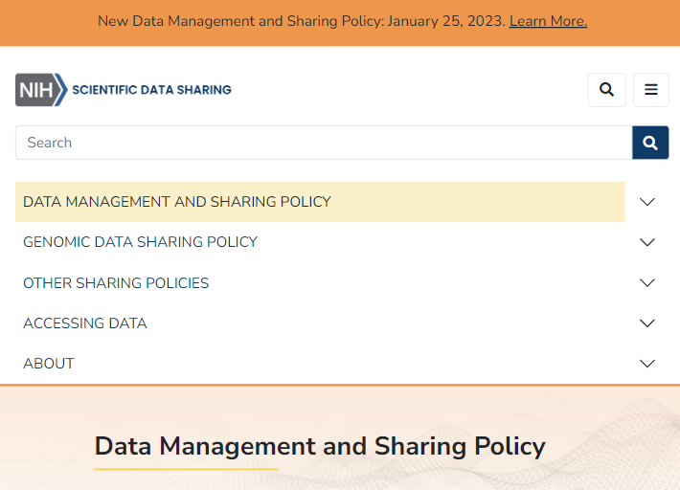
Putting it all together into a DMS/DMP
Recap of the key concepts and tools covered during the week.
Discussion on how to incorporate these elements into a Data Management and Sharing plan (DMS) or Data Management Plan (DMP).
Hands-on session on drafting a DMS/DMP that adheres to the FAIR and CARE principles.
Notes:
"Finally, on Friday, we'll be putting everything together. We'll recap the key concepts and tools we've covered during the week and discuss how to incorporate these elements into a Data Management and Sharing plan, or DMS, and a Data Management Plan, or DMP. In our hands-on session, you'll get to draft a DMS/DMP that adheres to the FAIR and CARE principles. By the end of the day, and the end of our course, you'll have a practical roadmap for implementing these principles in your own work."

Slide 18
Roadmap
Intro - Big Picture - 6/26
Define FAIR meta(data) – 6/27
Collect FAIR meta(data) – 6/28
Utilize FAIR meta(data) – 6/29
Putting it all together in a DMS/DMP – 6/30

Slide 19
Domain Discussion
To transition into the next few days of practicals it would be useful to understand what type of data/metadata participants work with.
Each participant to give 1 minute summary of the type of data and metadata they commonly use

Slide 20
Thanks!

